Slide 1
Sequential Circuits

Slide 2
Index
Sequential Logic
Bistable element
SR Latch
D Latch
Clock
D Flip-Flop
Register
Enabled Flip-Flop
Resettable Flip-Flop
Transistor-Level Design
Astable circuits
Race Condition
Asynchronous circuits
Synchronous circuits
Synchronous vs Asynchronous Circuits

Slide 3
Sequential Logic
The output of combinational logic depends only on current input values
given a specification in the form of a truth table or boolean equation, we can create an optimized circuit to meet the specification
The outputs of sequential logic depend on both current and prior input values
has memory
explicitly remember previous inputs
or it might distil the prior inputs into a smaller amount of information called the state of the system
a set of bits (state variables) that contain all the information about the past necessary to explain the future behaviour of the circuit
latches and flip-flops are simple sequential circuits that store one bit of state
Sequential circuits are complicated to analyse
we can discipline ourselves to build only synchronous sequential circuits
combinational logic and banks of flip-flops containing the state of the circuit

Slide 4
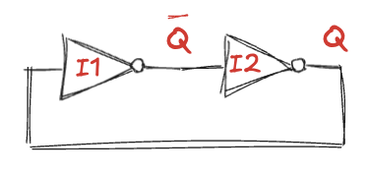
Bistable element (1)
The fundamental building block of memory: an element with two stable states
The inverters are cross-coupled
the input of I1 is the output of I2 and vice versa
the circuit has no inputs, but it does have two outputs
This circuit is cyclic
Case 1: Q = 0
I2 receives a FALSE input, so it produces a TRUE output on Q
I1 receives a TRUE input, so it produces a FALSE output on Q
this is consistent with the original assumption (Q = 0), so it is stable
Case 2: Q = 1
I2 receives a TRUE input and produces a FALSE output on Q
I1 receives a FALSE input and produces a TRUE output on Q
this is again stable
Because the cross-coupled inverters have two stable states, the circuit is said to be bistable

Slide 5
Bistable element (2)
An element with N stable states conveys log₂N bits of information, so a bistable element stores one bit
state of the cross-coupled inverters is contained in one binary state variable (Q)
the value of Q tells us everything about the past that is necessary to explain the future behaviour of the circuit
if Q=0, it will remain 0 forever
if Q=1, it will remain 1 forever
When power is first applied to a sequential circuit, the initial state is unknown and usually unpredictable
it may differ each time the circuit is turned on
Although the cross-coupled inverters can store a bit of information, they are not practical because the user has no inputs to control the state

Slide 6
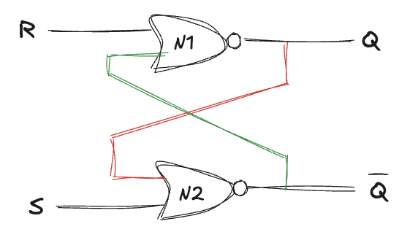
SR Latch (1)
Two cross-coupled NOR gates
Like the cross-coupled inverters, but its state can be controlled through the inputs
set (S) and reset (R) the output
Case 1: R=1, S=0
N1 sees at least one TRUE input R, so it produces a FALSE output on Q
N2 sees both Q and S FALSE, so it produces a TRUE output on Q
Case 2: R=0, S=1
N1 receives inputs of 0 and Q, however we don’t yet know Q
N2 receives at least one TRUE input S, so it produces a FALSE output on Q
Now we can revisit N1, so the output Q is TRUE

Slide 7
SR Latch (2)
Case 3: R=1, S=1
N1 and N2 both see at least one TRUE input, so each produces a FALSE output
Case 4: R=0, S=0
N1 receives inputs of 0 and Q, however we don’t yet know Q
N2 receives inputs of 0 and Q. however we don’t yet know Q
now we are stuck, but we know that Q must either be 0 or 1
Case 4a: Q=0
N2 produces a TRUE output on Q
N1 receives one TRUE input (Q), so its output is FALSE, just as we had assumed
Case 4b: Q=1
N2 produces a FALSE output on Q
N1 receives two FALSE inputs, so its output is TRUE, just as we had assumed
Putting this all together: when R and S are 0, Q will remember the old value
this circuit has memory

Slide 8
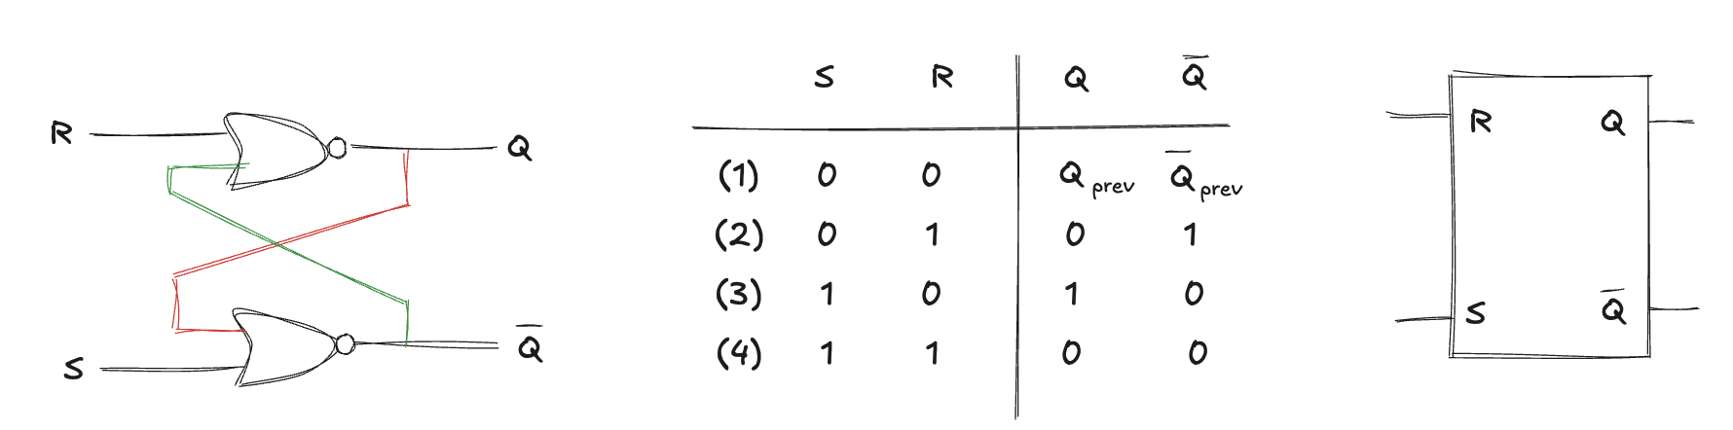
SR Latch (3)
The truth table summarizes these four cases
The inputs S and R stand for Set and Reset
“set” a bit means to make it TRUE
“reset” a bit means to make it FALSE
When neither input is asserted, Q remembers its old value
Asserting both S and R simultaneously doesn’t make sense
it means the latch should be set and reset at the same time
the confused circuit responds by making both outputs 0

Slide 9
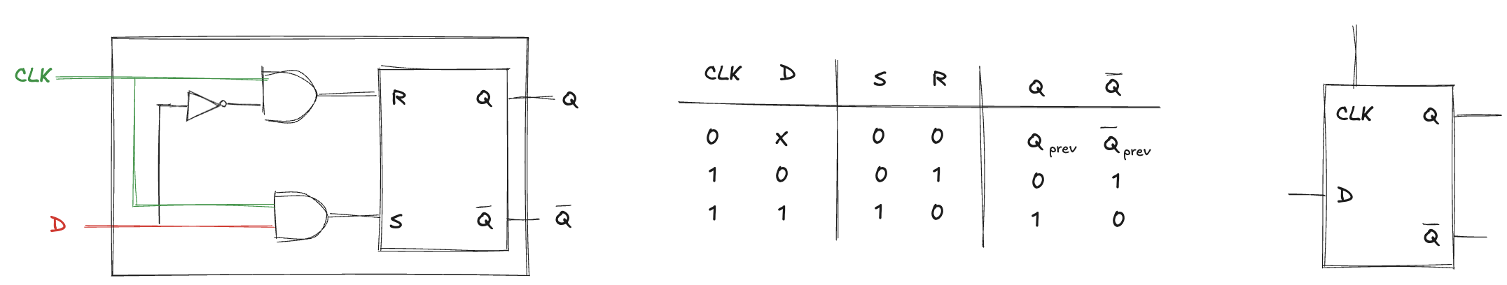
D Latch
SR latch is awkward
it behaves strangely when both S and R are simultaneously asserted
moreover, S and R conflate the issues of what and when
asserting one input determines what the state should be and when it should change
Design is easier when these questions (what and when) are separated
The D latch avoids the strange case of simultaneously asserted R and S inputs
data input D controls what the next state should be
clock input CLK controls when the state should change
if CLK=0, S and R are FALSE (regardless of D) and Q remembers its old value
if CLK=1, one AND is TRUE and the other is FALSE (depending on D) and Q = D
In all cases, Q is the complement of Q

Slide 10
Clock
The clock controls when data flows through the latch
when CLK = 1, the latch is transparent
data at D flows through to Q as if the latch were just a buffer
when CLK = 0, the latch is opaque
it blocks the new data from flowing through to Q, and Q retains the old value

Slide 11
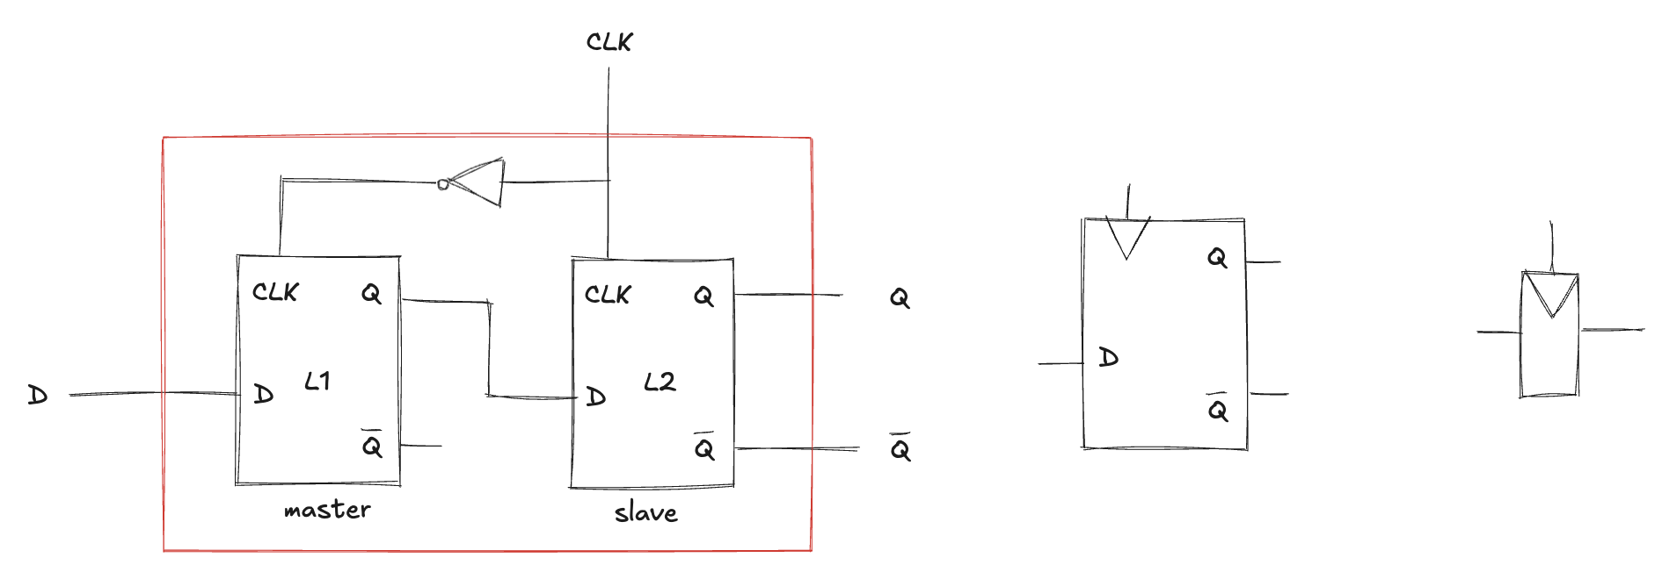
D Flip-Flop
Two back-to-back D latches controlled by complementary clocks
L1 is called the leader/master
L2 is called the follower/slave
It copies D to Q on the rising edge of the clock and remembers its state at all other times:
when CLK=0, the master is transparent and the slave is opaque
when CLK=1, the master goes opaque and the salve becomes transparent
The D input specifies what the new state will be, the clock edge indicates when the state should be updated

Slide 12
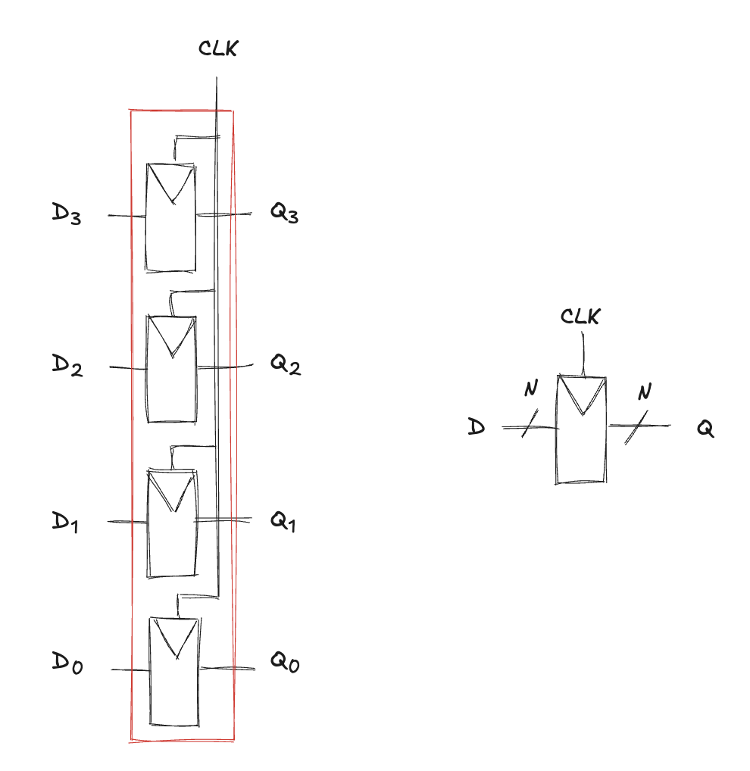
Register
An N-bit register is a bank of N flip-flops that share a common CLK
all bits of the register are updated at the same time
registers are the key building block of most sequential circuits

Slide 13
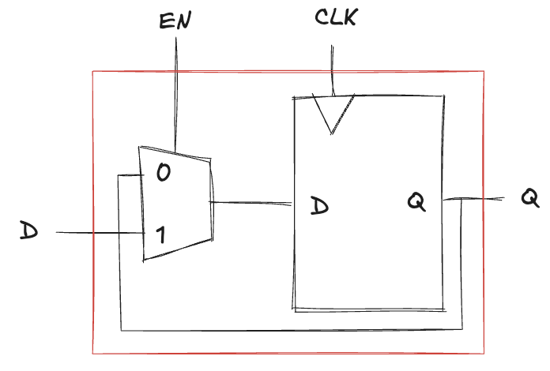
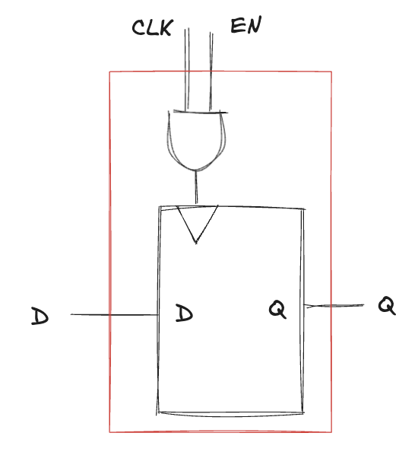
Enabled Flip-Flop
Another input called Enable to determine if data is loaded on the clock edge
when Enable is TRUE, the flip-flop behaves like an ordinary D flip-flop
when Enable is FALSE, the flip-flop ignores the clock and retains its state
Useful when we wish to load a new value into a flip-flop only some of the time, rather than on every clock edge
Two ways to implement it
an input multiplexer:
the value D pass if Enable is TRUE
the old state is recycled if Enable is FALSE
the clock can be gated:
if Enable is TRUE, the CLK toggles normally
if Enable is FALSE, the CLK input is also FALSE
notice that Enable must not change while CLK=1 or the flip-flop see a clock glitch (switch at an incorrect time)
Generally, performing logic on the clock is a bad idea

Slide 14
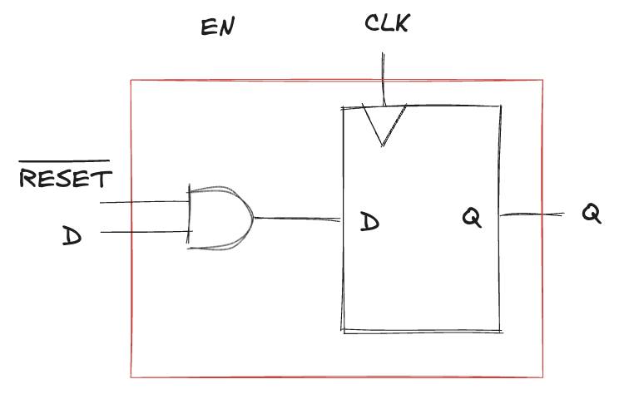
Resettable Flip-Flop
Another input, called Reset
when Reset is FALSE, the flip-flop behaves like an ordinary D flip-flop
when Reset is TRUE, the flip-flop ignores D and resets the output to 0
Useful when we want to force a known state into all the flip-flops in a system when we first turn it on
We can construct it from an ordinary D flip-flop and an AND gate
the reset is an active low signal, meaning that it performs its function when it is 0
by adding an inverter, the circuit could have accepted an active high reset signal

Slide 15
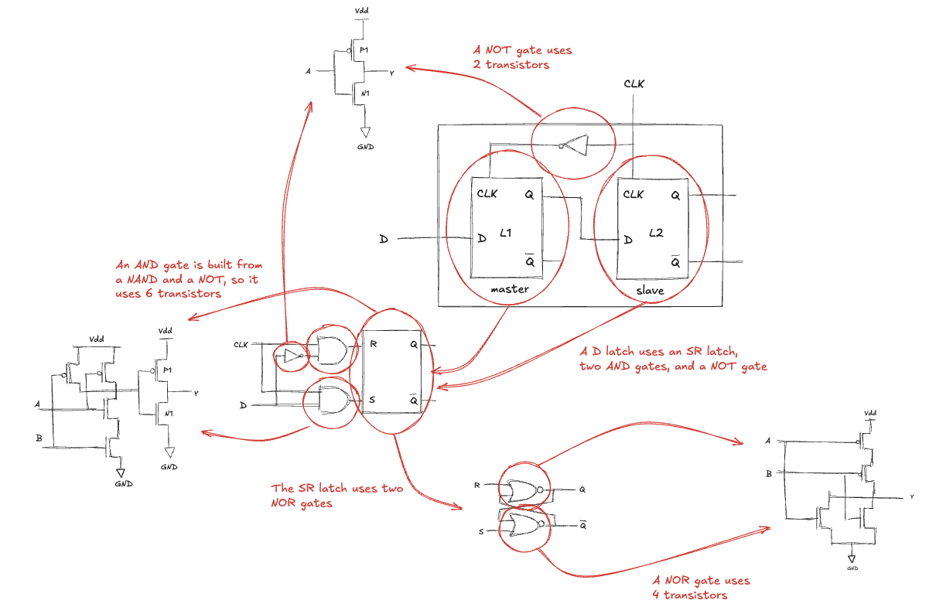
Transistor-Level Design (1)
How many transistors are needed to build the D flip-flop?
The D flip-flop uses 46 transistors!

Slide 16
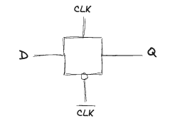
Transistor-Level Design (2)
Many transistors when built from logic gates!
Its fundamental role is to be transparent or opaque, much like a switch
A compact D latch can be constructed from a single transmission gate
when CLK=1, the transmission gate is ON, so D flows to Q and the latch is transparent
when CLK=0, the transmission gate is OFF, so Q is isolated from D and the latch is opaque
Two major limitations:
floating node: when the latch is opaque, Q is not held at its value by any gates, after some time, noise and charge leakage may disturb the value of Q
no buffers
a spike of noise that pulls D to a negative voltage can turn on the nMOS transistor, making the latch transparent, even when CLK=0;
likewise, a spike on D above VDD can turn on the pMOS transistor even when CLK=0
neither the input of a transmission gate nor the state node of a sequential circuit should ever be exposed to the outside world where noise is likely

Slide 17
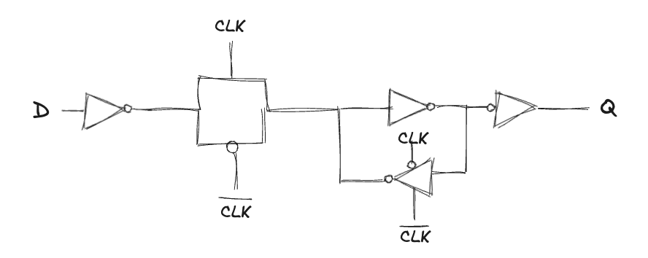
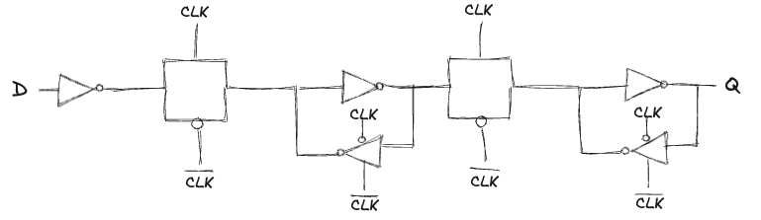
Transistor-Level Design (3)
A more robust (12-transistor) D latch used on modern commercial chips
still built around a clocked transmission gate
adds inverters to buffer the input and output
however, it is outside the scope of this course…
So, a D flip-flop requires only 20 transistors:

Slide 18
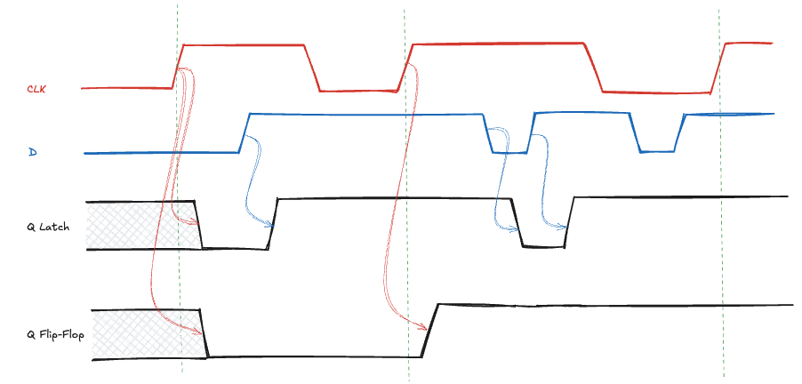
Flip-Flop and Latch comparison
Apply D and CLK inputs to a D latch and a D flip-flop to determine Q
The initial value of Q is unknown
Consider the latch:
on the first CLK rising edge, D=0 so Q becomes 0
each time D changes while CLK=1, Q follows
when D changes while CLK=0, D is ignored
Consider the flip-flop:
on each CLK rising edge, D is copied to Q
at all other times, Q retains its state

Slide 19
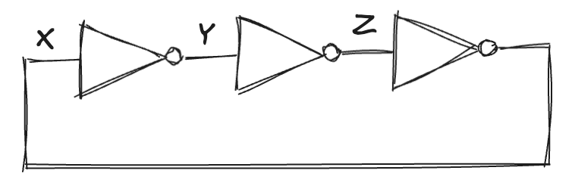
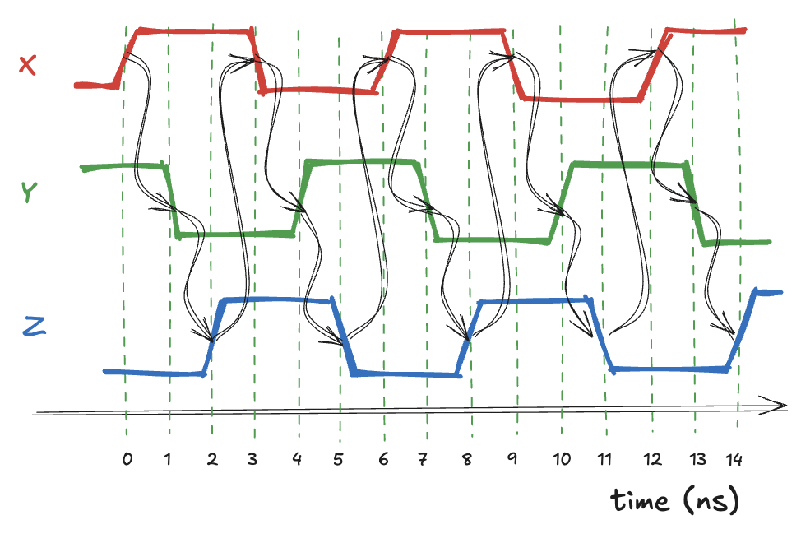
Problematic circuit: astable circuits
Consider the three inverters tied in a loop
each inverter has a delay of 1ns
Suppose X is initially 0, then Y=1, Z=0, and, hence, X=1
which is inconsistent with original assumption
the circuit has no stable states and is said to be unstable or astable
The period of the oscillator depends on the propagation delay
if X rises at t=0, Y falls at 1ns, Z rises at 2ns, and X falls at 3ns
in turn, Y rises at 4ns, Z falls at 5ns, and X rises again at 6ns
then, the pattern will repeat: each node oscillates with a period of 6 ns
this circuit is called a ring oscillator
The gate delay depends on how the inverter was manufactured, the power supply voltage, and even the temperature
the ring oscillator period is difficult to accurately predict

Slide 20
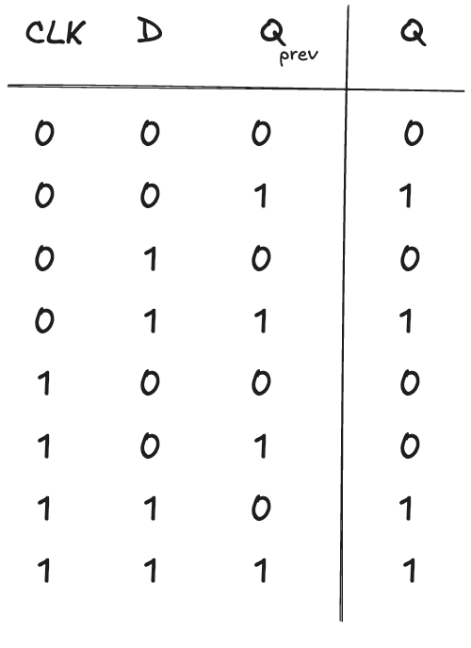
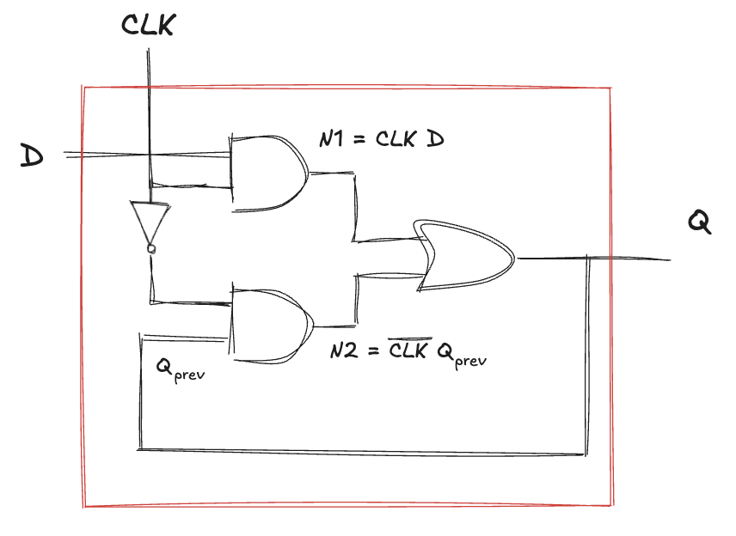
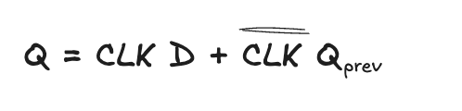
Problematic circuit: race condition
Consider the following circuits, it seems a good implementation of a D latch (it use fewer gates):
The circuit has a race condition that causes it to fail when certain gates are slower than others:
suppose that CLK=D=1, the latch is transparent and passes D through to make Q=1
now, CLK falls, the latch should remember its old value, keeping Q=1
however, if the delay through the inverter is longer than delays of AND and OR
N1 and Q may both fall before CLK rises
N2 will never rise, and Q becomes stuck at 0

Slide 21
Problematic circuit: asynchronous circuits
The previous examples contain loops called cyclic paths
outputs are directly fed back to inputs
The behaviour depends on which of the paths through logic gates is fastest
asynchronous circuits
a circuit works, an identical one built of gates with different delays may not work
a circuit works only at certain temperatures at which the delays are just right
these malfunctions are extremely difficult to track down
We break the cyclic paths by inserting registers
transforms the circuit into a collection of combinational logic and registers
registers contain the state of the system, which changes only at the clock edge
the state is synchronized to the clock
if the clock is sufficiently slow all races are eliminated
inputs to all registers settle before the next clock edge

Slide 22
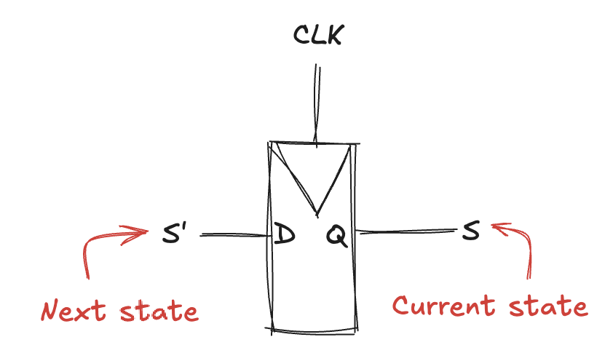
Synchronous circuits (1)
A synchronous sequential circuit has a clock input, whose rising edges indicate a sequence of times at which state transitions occur
current state and next state distinguish the state of the system at the present from the state to which it will enter on the next clock edge
Rules of synchronous sequential circuit composition
a circuit is a synchronous if it consists of interconnected elements, such that
every element is either a register or a combinational circuit
at least one circuit element is a register
all registers receive the same clock signal
every cyclic path contains at least one register
A flip-flop is the simplest synchronous sequential circuit
it has one input, one clock, one output, and two states
the next state is D and the output Q is the current state

Slide 23
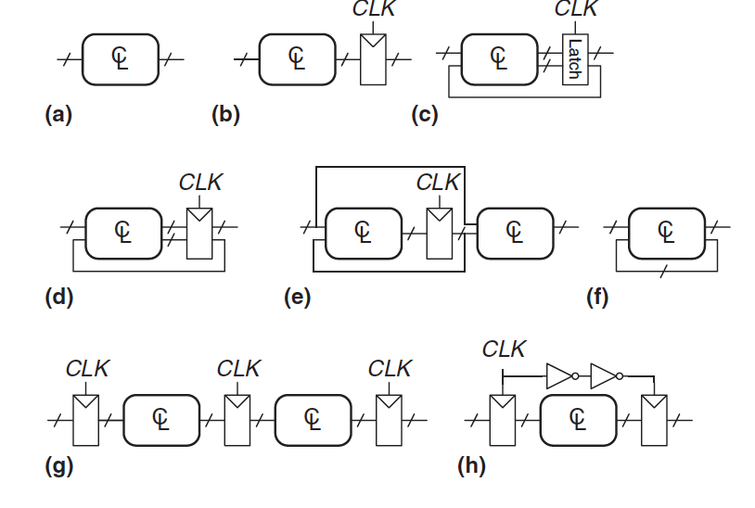
Synchronous circuits (2)
Which of the following circuits are synchronous sequential circuits?
(a) is combinational
it has no registers
(b) is sequential with no feedback
(c) no combinational, no synchronous
it has a latch that is neither a register nor a combinational circuit
(d) (e) are synchronous sequential logic
(f) no combinational, no synchronous sequential
it has a cyclic path but no register in the path
(g) is synchronous sequential logic
(h) is not, strictly speaking, a synchronous sequential circuit
the second register receives a different clock signal than the first, delayed by two inverter delays

Slide 24
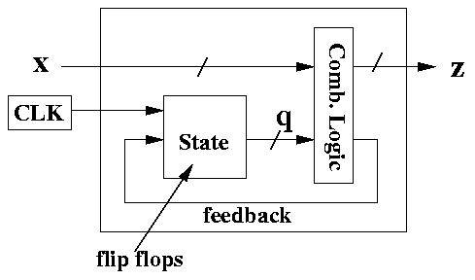
Synchronous circuits (3)

Slide 25
Synchronous vs Asynchronous Circuits
Asynchronous design is more general than synchronous design
the timing of the system is not limited by clocked registers
(just as analog circuits are more general than digital circuits)
Synchronous circuits are easier to design than asynchronous circuits
(just as digital are easier than analog circuits)
Despite decades of research on asynchronous circuits, virtually all digital systems are essentially synchronous
Asynchronous circuits are occasionally necessary when communicating between systems with different clocks or when receiving inputs at arbitrary times
(just as analog circuits are necessary when communicating with the real world of continuous voltages)

Slide 26
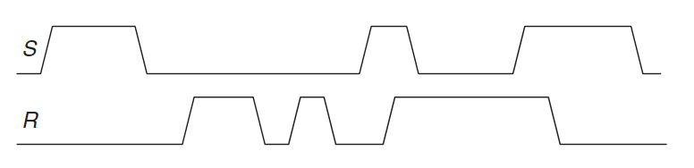
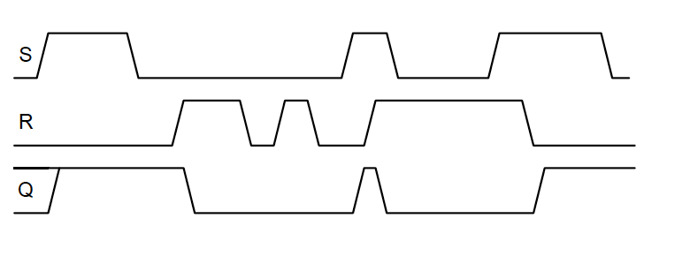
Exercises (1)
Ex09.1: Given the input waveforms below, sketch the output of an SR latch
Solution:

Slide 27
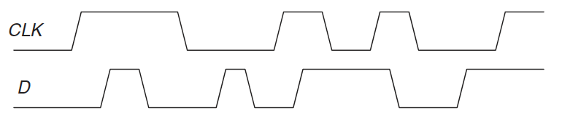
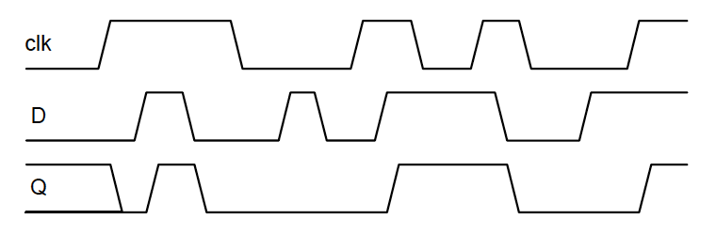
Exercises (2)
Ex09.2: Given the input waveforms below, sketch the output of an D latch
Solution:

Slide 28
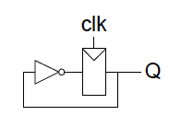
Exercises (3)
Ex09.3: The toggle (T) flip-flop has one input, CLK, and one output, Q. On each rising edge of CLK, Q toggles to the complement of its previous value. Draw a schematic for a T flip-flop using a D flip-flop and an inverter?
Solution:

Slide 29
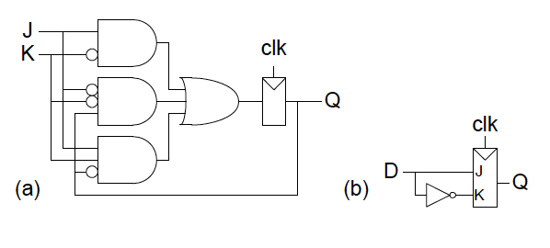
Exercises (4)
Ex09.4: A JK flip-flop receives a clock and two inputs, J and K. On the rising edge of the clock, it updates the output, Q. If J and K are both 0, Q retains its old value. If only J is 1, Q becomes 1. If only K is 1, Q becomes 0. If both J and K are 1, Q becomes the opposite of its present state. (a) Construct a JK flip-flop, using a D flip-flop and some combinational logic. (b) Construct a D flip-flop, using a JK flip-flop and some combinational logic.
Solution:

